Slide 1
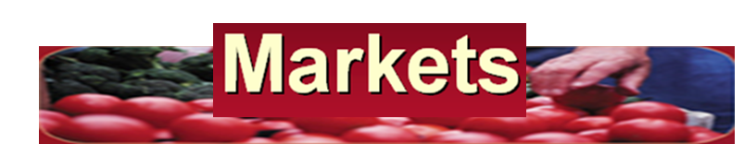
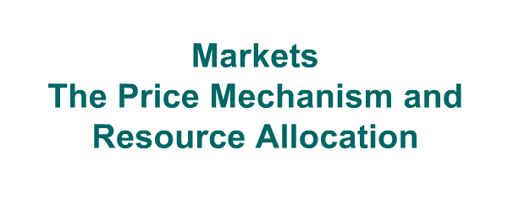
Objectives:
To explain the functions of price mechanism & transmission of preference

Slide 2
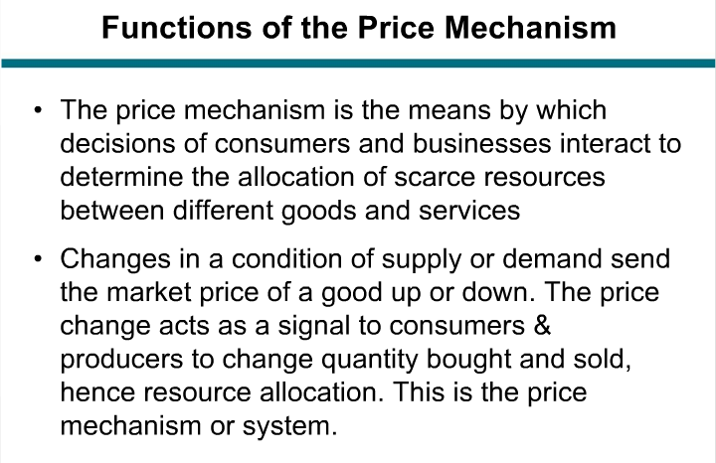

Slide 3
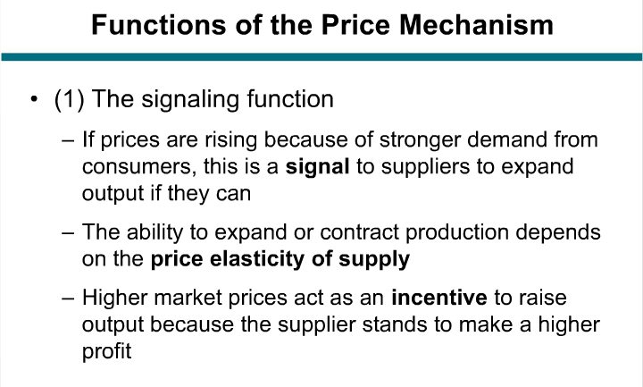

Slide 4
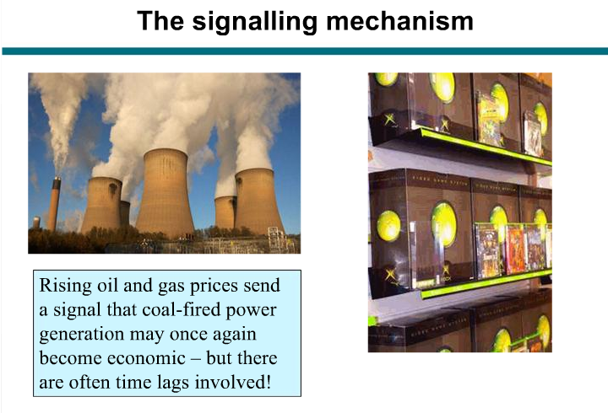
Functions of price mechanism

Slide 5
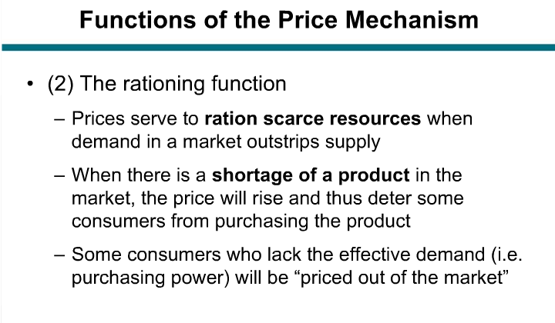

Slide 6
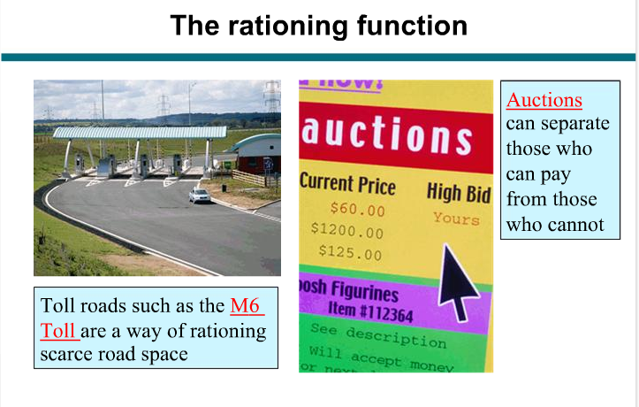

Slide 7
Transmission of preference
The automatic way in which the market allows the preference of consumers to be made known to producers through the voting power in the market

